Slide 1
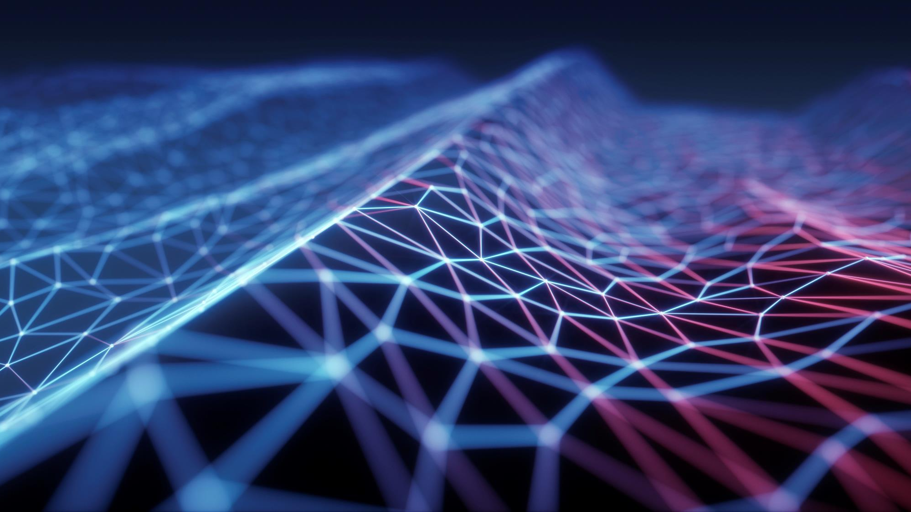
Handwritten digit recognition

Slide 2
Introduction
Handwritten digit recognition using MNIST dataset is a major application made with the help of Neural Network. It basically detects the scanned images of handwritten digits.
We have taken this a step further where our handwritten digit recognition system not only detects scanned images of handwritten digits but also allows writing digits on the screen.
We will approach this project by using a three-layered Neural Network.
The input layer: It distributes the features of our examples to the next layer for calculation of activations of the next layer.
The hidden layer: They are made of hidden units called activations providing nonlinear ties for the network. A number of hidden layers can vary according to our requirements.
The output layer: The nodes here are called output units. It provides us with the final prediction of the Neural Network on the basis of which final predictions can be made.

Slide 3
Handwritten digit recognition using neural network
The idea is to take a large number of handwritten digits, known as training examples, and then develop a system which can learn from those training examples. In other words, the neural network uses the examples to automatically infer rules for recognizing handwritten digits.
Furthermore, by increasing the number of training examples, the network can learn more about handwriting, and so improve its accuracy. So if we use 100 training digits above, perhaps we could build a better handwriting recognizer by using thousands or even millions or billions of training examples.

Slide 4
Handwritten digit recognition using neural network
Challenges of Handwritten digit recognition
Poor quality of the source document/image due to degradation over time.
Cursive handwriting.
Also a disadvantage, that it is not done in real time as a person writes and therefore not appropriate for immediate text input

Slide 5
Algorithm of handwritten digits recognition
1. Import the libraries and load the dataset.
2. Preprocess the data (split the data into training data and testing data and normalize it).
3. Create the neural network model.
4. Add Layers to the model.
5. Train the model.
6. Evaluate the model.
7. Predict digits.

Slide 6
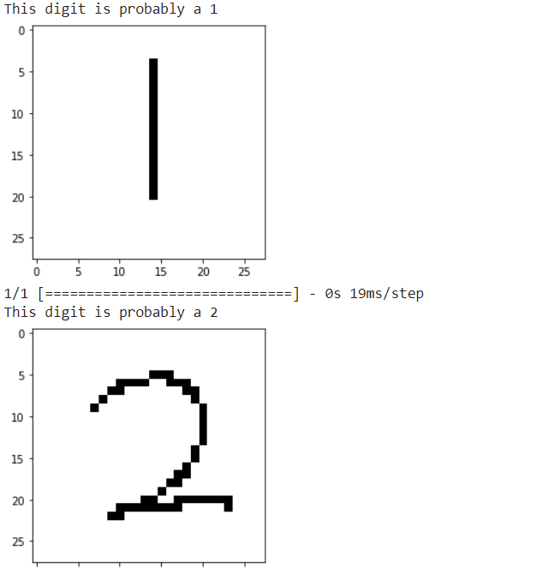
The Result of the algorithm:
Now we’re to have some handwritten digits and we will feed them to the model to predict the digits. Upload some handwritten digits and it will be classified using neural network.

Slide 7
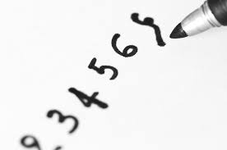
Thank You
Malak Mahmoud aref

